Slide 1
JAVA Lecture 8
Introduction to Strings

Slide 2
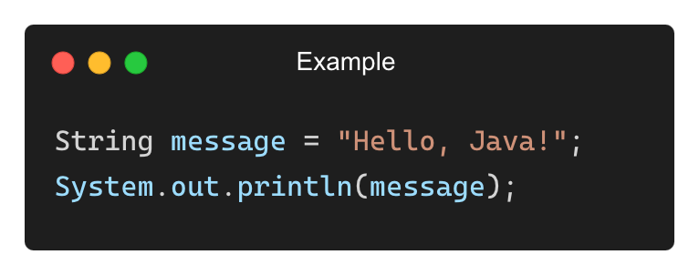
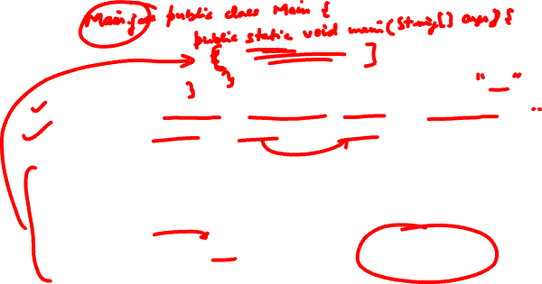
What is a String?
A string is a sequence of characters enclosed in double quotes ("").
Java treats strings as objects of the String class.
Output:
Hello, Java!

Slide 3
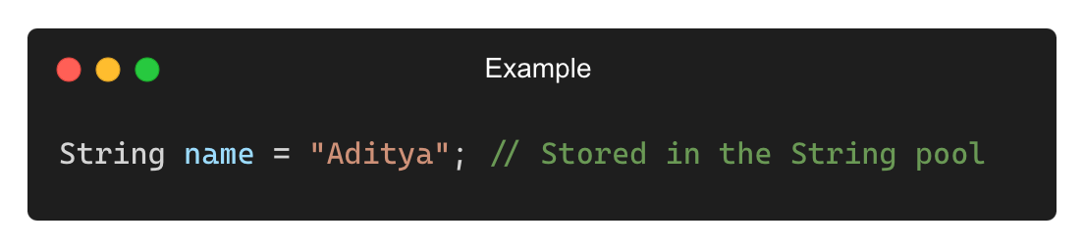
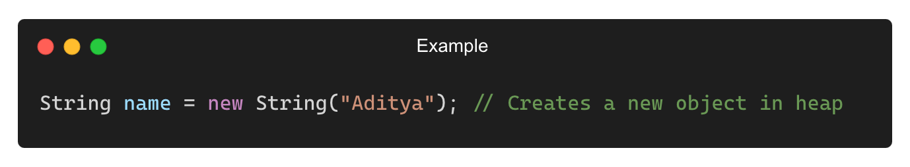
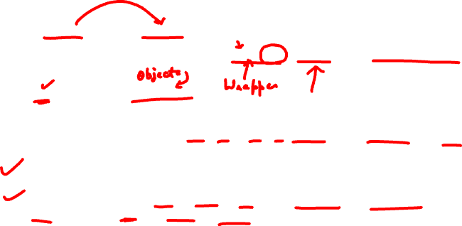
Creating Strings in Java
Using String Literals (Stored in String Pool):
Using new Keyword (Stored in Heap Memory):
Difference Between String Pool and Heap:
✅ String literals are stored in a special memory area called the String pool to avoid duplication.
✅ Strings created using new are stored in heap memory.

Slide 4
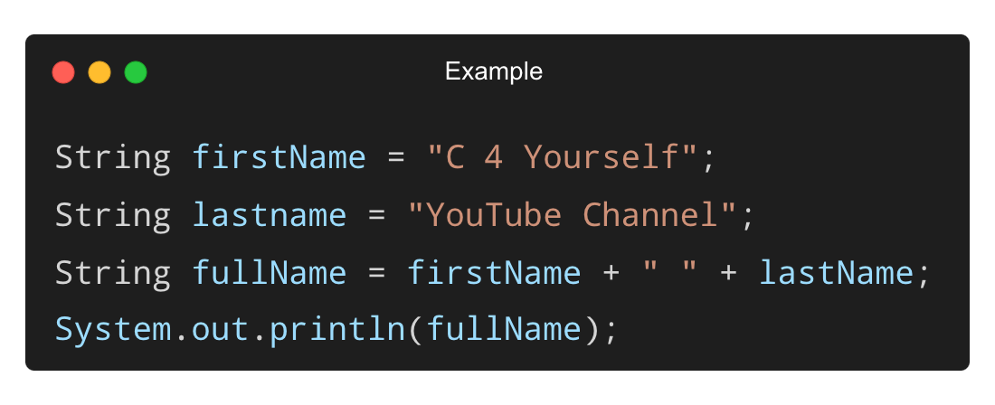
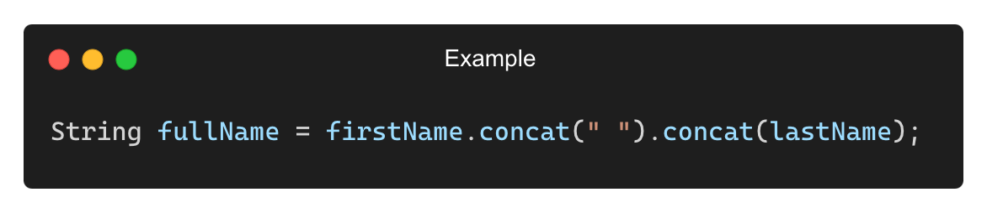
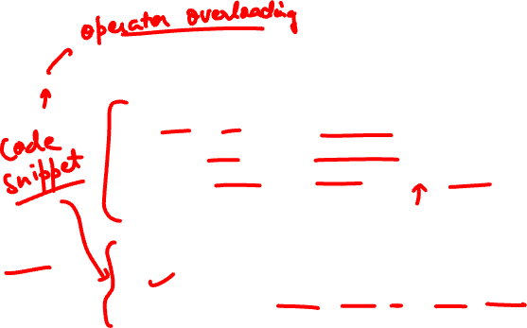
Concatenating Strings
Using + Operator:
Using concat() Method:

Slide 5
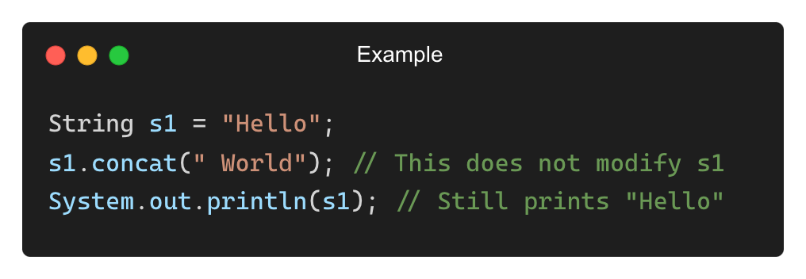
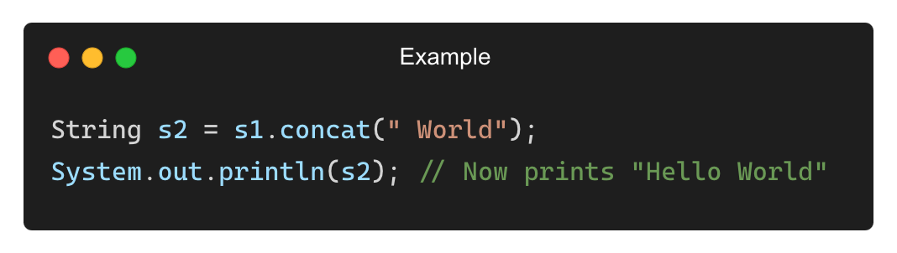
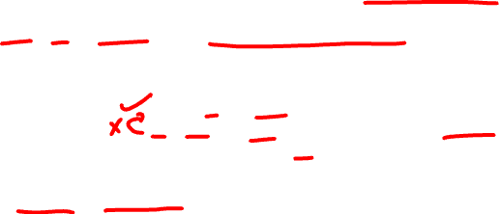
String Immutability in Java
Strings in Java are immutable, meaning they cannot be changed after creation.
To modify a string, assign the result to a new variable:

Slide 6
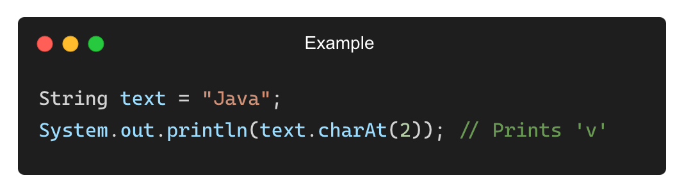
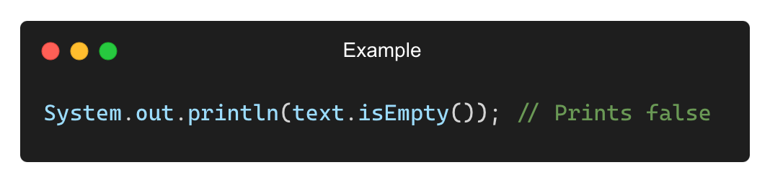
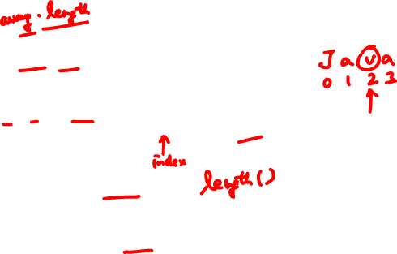
Extracting Characters from a String
Using charAt(index):
Finding String Length (length()):

Slide 7
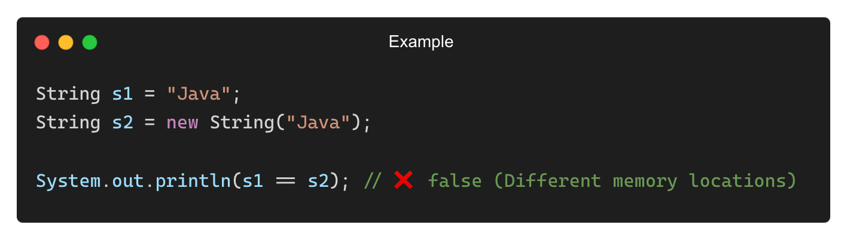
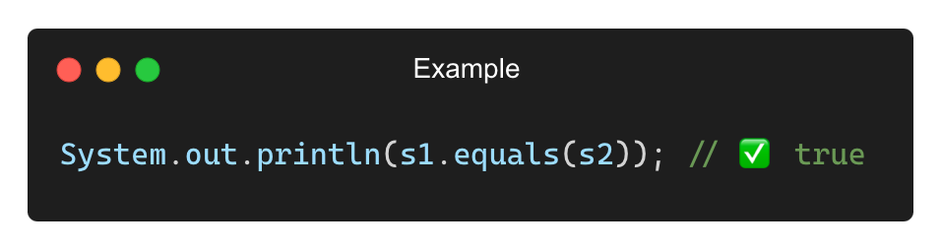
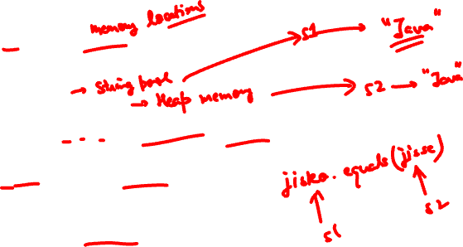
Comparing Strings
Using == (Compares references, not values):
Using .equals() (Compares actual values):

Slide 8
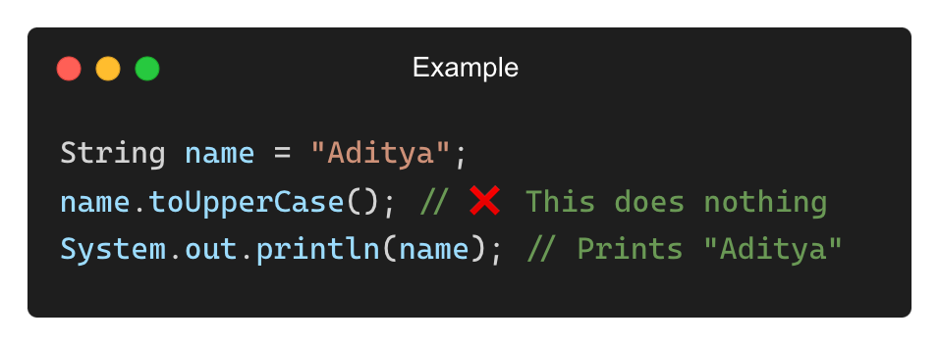
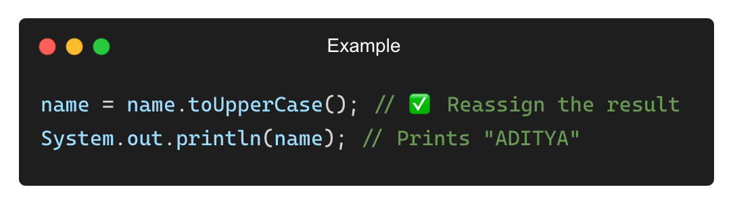

Common Mistakes with Strings
❌ Modifying Strings Without Reassigning
✅ Solution:

Slide 9
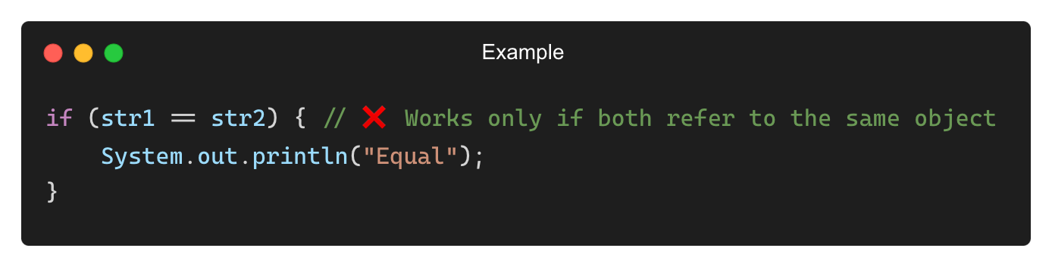
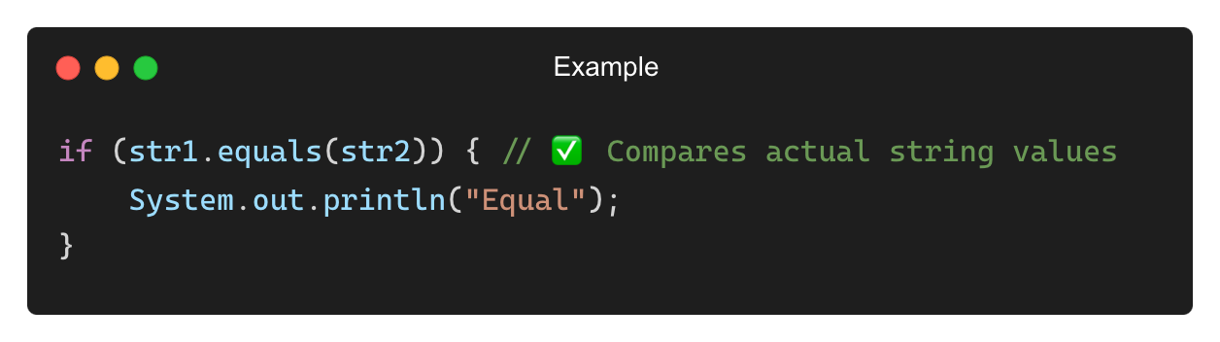
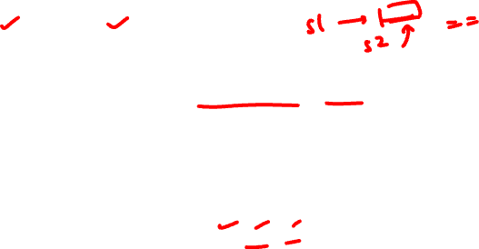
Common Mistakes with Strings (Contd.)
❌ Using == Instead of .equals() for Comparison
✅ Solution:

Slide 10
THANK YOU

